Slide 1
Workshop ‘Spatio-temporal modeling for ecology’
Stream network activity

Slide 2
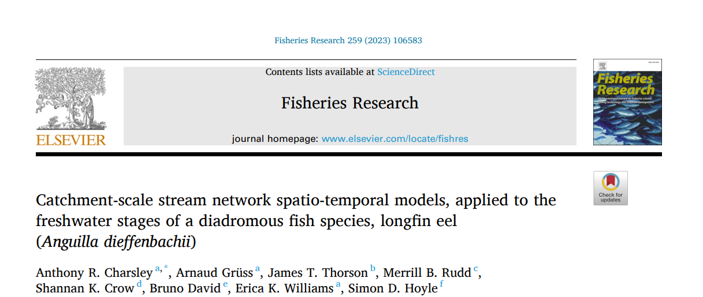
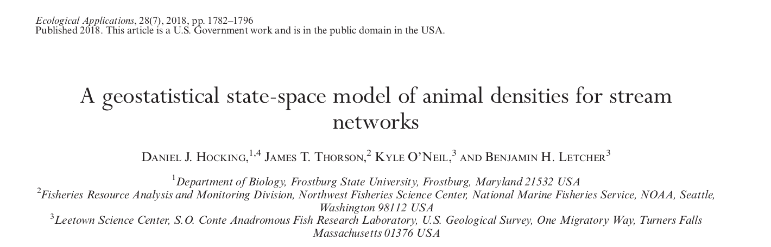
Some (bibliographic) context

Slide 3
Some (bibliographic) context

Slide 4
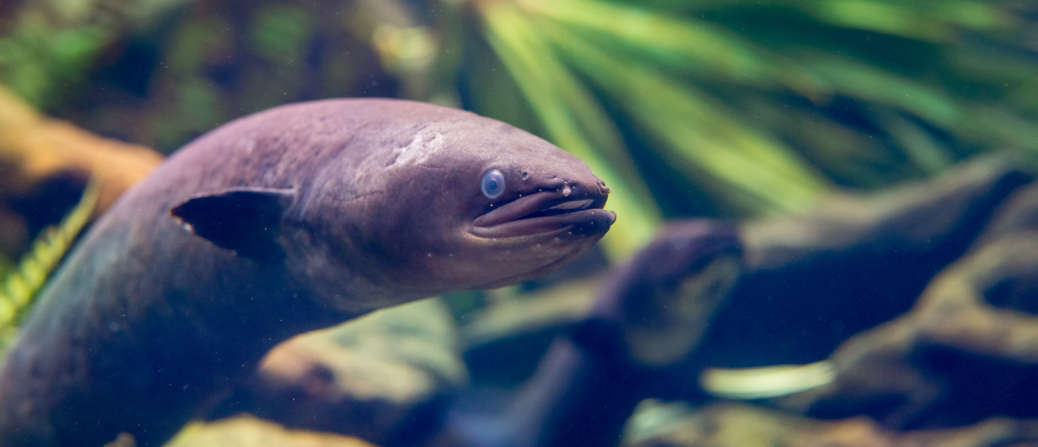
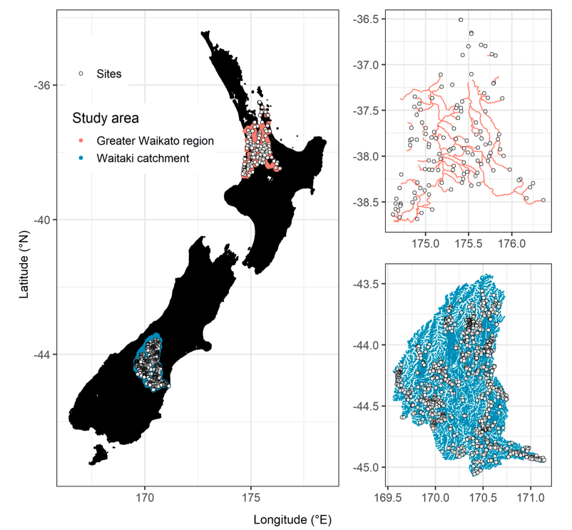
Overall framework
Case study: Longfin eel (Anguilla dieffenbachii), New Zealand
Ecological objective: estimating spatio-temporal changes in longfin eel populations in the freshwater environment
Data: Presence absence / Count data of eels, various fishing methods
Covariates (e.g. mean flow, distance to coast, mean elevation)
Statistical model: VAST + adaptation to stream network

Slide 5
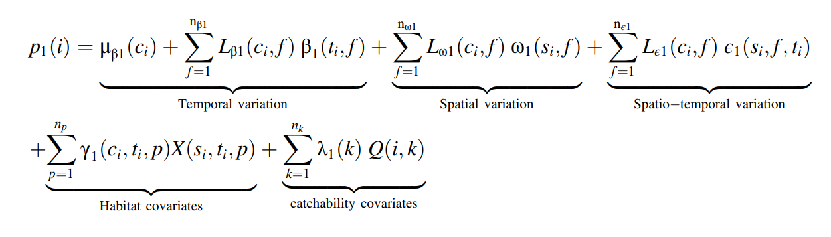
Modeling framework | VAST
Category
(e.g. species)
Number of temporal effects
Number of spatial effects
Number of spatio-temporal effects
Linear predictor for observation i
Number of habitat covariates
Number of catchability covariates

Slide 6
Modeling framework | VAST
Category
(e.g. species)
Number of temporal effects
Number of spatial effects
Number of spatio-temporal effects
Linear predictor for observation i
Number of habitat covariates
Number of catchability covariates
Temporal, spatial and spatio-temporal random effects

Slide 7
Modeling framework | VAST
Category
(e.g. species)
Number of temporal effects
Number of spatial effects
Number of spatio-temporal effects
Linear predictor for observation i
Loading terms
Relate the temporal, spatial and spatio-temporal effects to categories/species
Number of habitat covariates
Number of catchability covariates
Temporal, spatial and spatio-temporal random effects

Slide 8
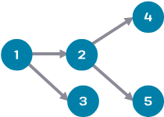
Modeling framework | Modelling spatio-temporal dependence
Ornstein-Uhlenbeck process
Define the acyclic graph of upstream “child” and downstream “parent”

Slide 9

Modeling framework | Modelling spatio-temporal dependence
Ornstein-Uhlenbeck process
Define the acyclic graph of upstream “child” and downstream “parent”
Expected spatial correlation between points in the stream network
Variance for spatial correlation for location s, conditioned upon the value for parent node s_{parent}

Slide 10
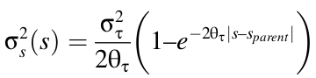
Modeling framework | Modelling spatio-temporal dependence
Ornstein-Uhlenbeck process
Define the acyclic graph of upstream “child” and downstream “parent”
Expected spatial correlation between points in the stream network
Variance for spatial correlation for location s, conditioned upon the value for parent node s_{parent}
Asymptotic variance for
two infinitely distant nodes
Distance between location s and parent node s_{parent}
Exponential rate of decorrelations
between child and parent nodes,
⇒ Larger values represent faster decorrelation

Slide 11

Modeling framework | Modelling spatio-temporal dependence
Ornstein-Uhlenbeck process
Define the acyclic graph of upstream “child” and downstream “parent”
Expected spatial correlation between points in the stream network
Variance for spatial correlation for location s, conditioned upon the value for parent node s_{parent}
Asymptotic variance for
two infinitely distant nodes
Distance between location s and parent node s_{parent}
Exponential rate of decorrelations
between child and parent nodes,
⇒ Larger values represent faster decorrelation

Slide 12

Modeling framework | Modelling spatio-temporal dependence
Ornstein-Uhlenbeck process
Define the acyclic graph of upstream “child” and downstream “parent”
Then define the precision matrix:
Exponential rate
of decorrelations
Precision ⇒ represents the conditional dependence of child nodes given parent nodes
Distance between location s and parent node s_{parent}

Slide 13
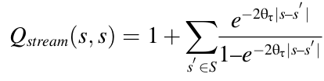
Modeling framework | Modelling spatio-temporal dependence
Ornstein-Uhlenbeck process
Define the acyclic graph of upstream “child” and downstream “parent”
Then define the precision matrix:
Exponential rate
of decorrelations
Precision ⇒ represents the conditional dependence of child nodes given parent nodes
Distance between location s and parent node s_{parent}
Diagonal terms of the precision matrix
Set of child and parent nodes
that are adjacent to node s

Slide 14
Modeling framework | Modelling spatio-temporal dependence
Ornstein-Uhlenbeck process
Define the acyclic graph of upstream “child” and downstream “parent”
Then define the precision matrix:
Markovian properties
Exponential rate
of decorrelations
Precision ⇒ represents the conditional dependence of child nodes given parent nodes
Distance between location s and parent node s_{parent}
Diagonal terms of the precision matrix
Set of child and parent nodes
that are adjacent to node s

Slide 15
Modeling framework | Modelling spatio-temporal dependence
Ornstein-Uhlenbeck process
Define the acyclic graph of upstream “child” and downstream “parent”
Then define the precision matrix.
Extension to time through a first-order autocorrelation process (not described here).

Slide 16
Modeling framework | Modelling spatio-temporal dependence
Ornstein-Uhlenbeck process
Define the acyclic graph of upstream “child” and downstream “parent”
Then define the precision matrix.
Extension to time through a first-order autocorrelation process (not described here).
Inference realized with TMB (standard for VAST/tinyVAST).

Slide 17
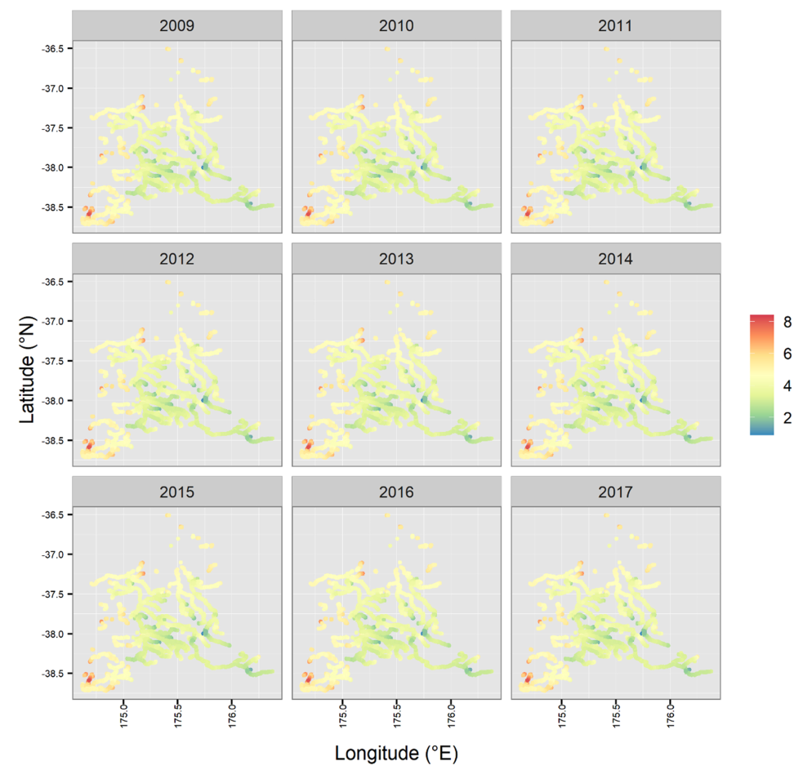
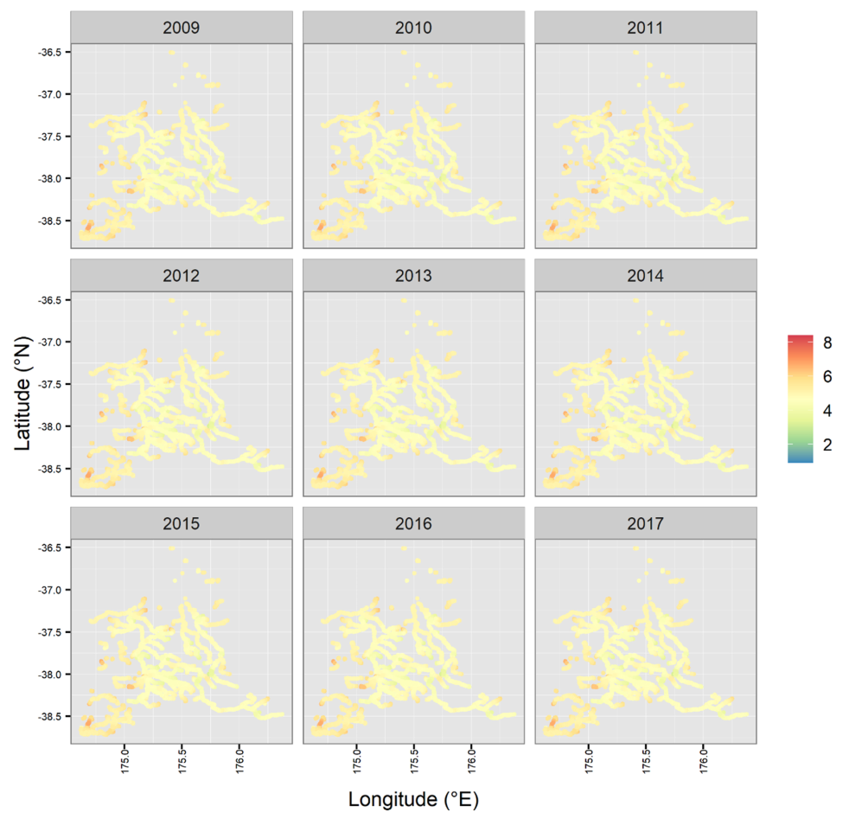
Some results
Map of predicted count/km
Large individuals (> 250mm)
Small individuals (< 250mm)

Slide 18
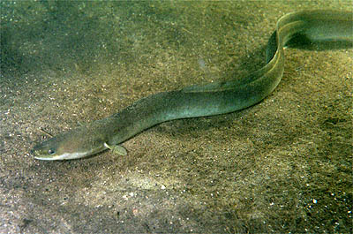
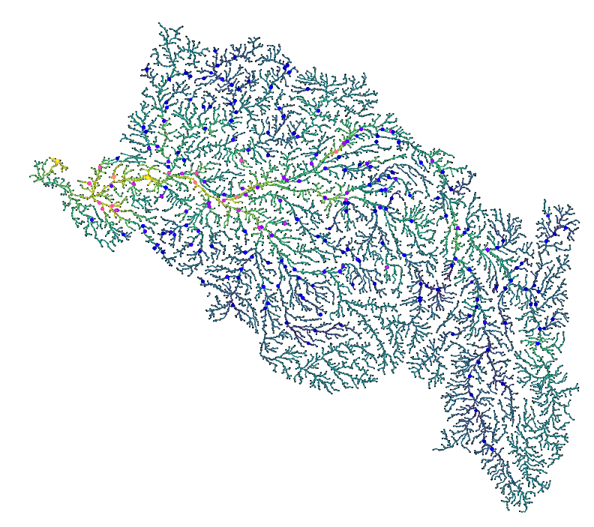
Our case study
Case study: Freshwater fish in the Loire River basin (France)
Ecological objective: Estimating spatio-temporal changes in fish populations in the freshwater environment
Data: Count data of freshwater fish in the Loire River bassin, 1990-2024 (ASPE database, OFB)
Covariates (e.g. distance to coast, elevation)
Statistical model: tinyVAST with adaptation to stream network
European eel spatial distribution in the Loire Bassin

Slide 19
Codes and questions to address
Lien codes
Lien données
Lien tutoriels tinyVAST
Lien présentation
Checking the network
Adding environmental covariates → need an interpolation step for prediction
Adding additional species (e.g. TRF – truite ; SPI – spirlin ; CHE – chevesne ; CHA – chabot ; LOF – loche franche)
Other questions ?

